Slide 1
Entrepreneurship

Slide 2


Slide 3


Slide 4


Slide 5


Slide 6


Slide 7


Slide 8


Slide 9
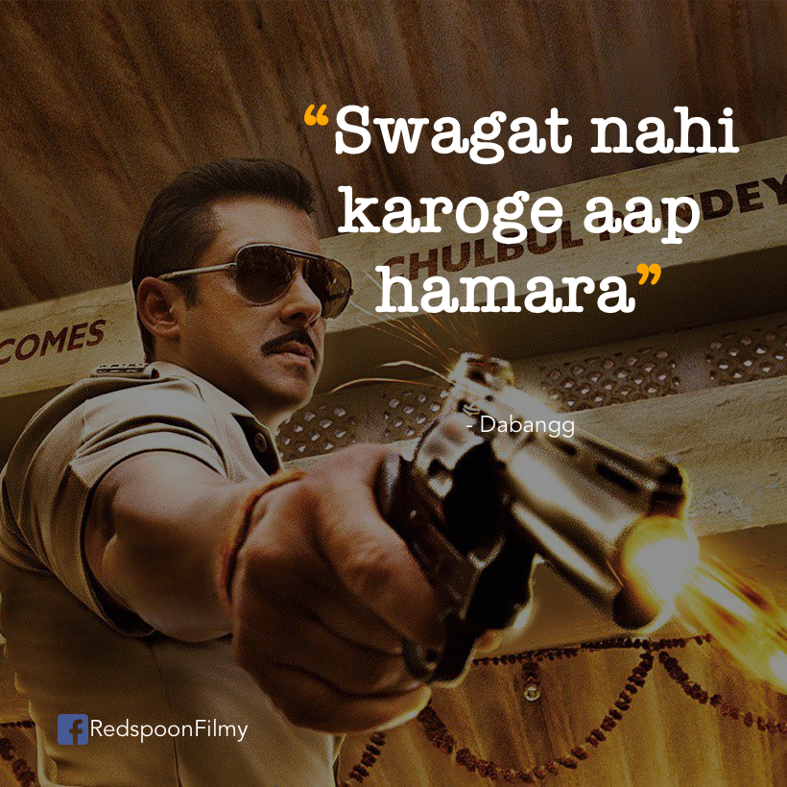

Slide 10

ROLE OF ENTREPRENEURSHIP IN INDIA
Increase opportunities for employment
Competitive skill sets
Additional wealth creation
Introduction and dissemination of new methods and technologies
Overall economic development

Slide 11
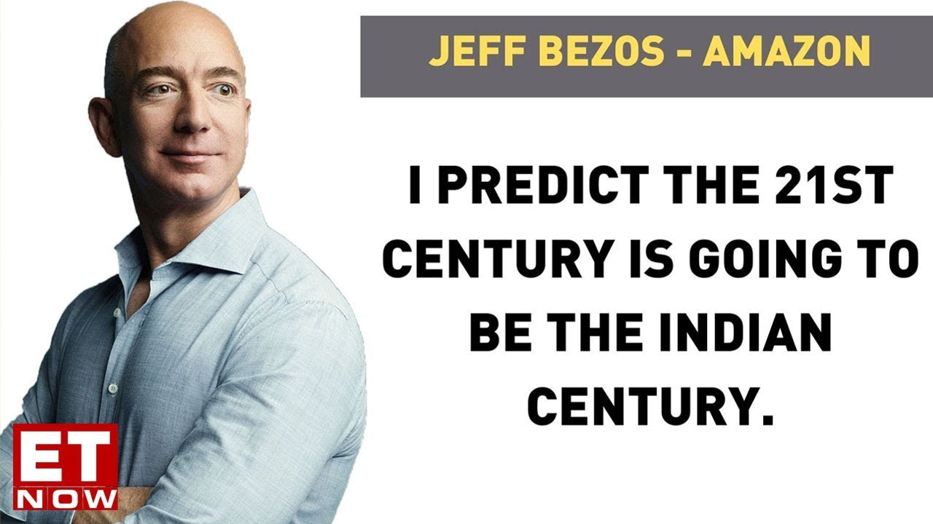

Slide 12
Rise of the global entrepreneurial class
The average Indian is about 29 years old in 2020 as compared to 48 in USA and 37 in china.
Therefore, there are more no. of youth in India as compared to that of USA and china.

Slide 13

Why there are so few entrepreneurs in India?
The education system
Lack of rebels
Mindset of society
Fear of failure
No passion for anything

Slide 14


Slide 15
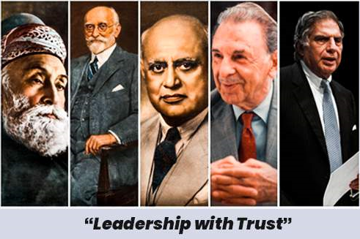
Entrepreneurship in india
TATA STEEL

Slide 16
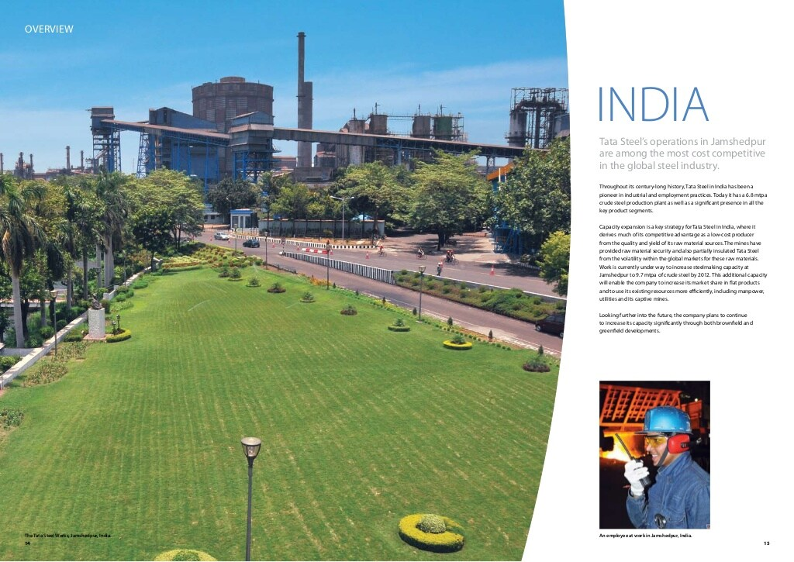
“A Pioneer in laying the economic foundation of a post Independence
India.”
TATA STEEL PLANT
JAMSHEDPUR

Slide 17
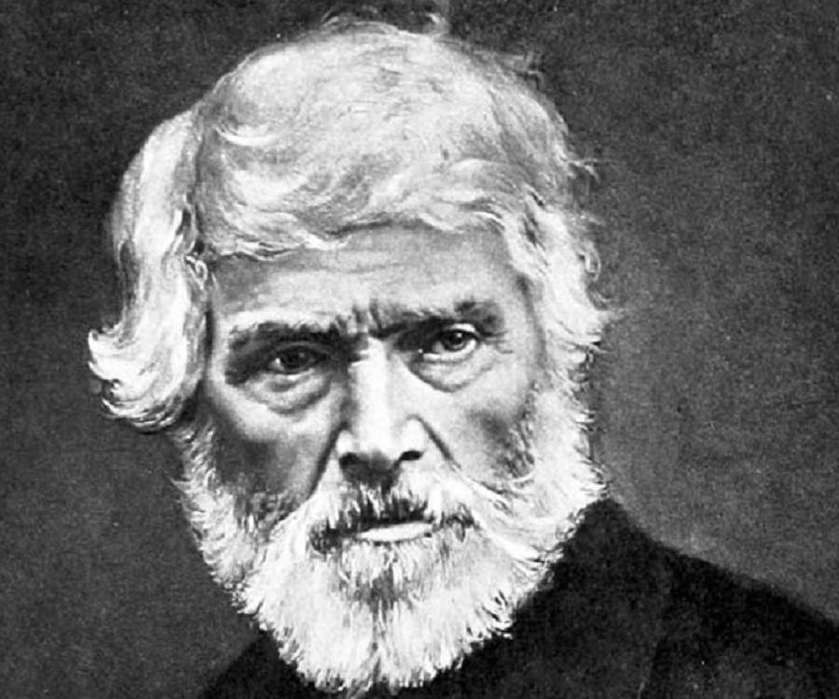
Thomas Carlyle
“A Nation that understood the value of Iron would reap its value in Gold”
Jamshetji Tata was so inspired by his lecture that he dedicated the next 30 years of his life tirelessly to establish the Iron and Steel Plant in India .

Slide 18
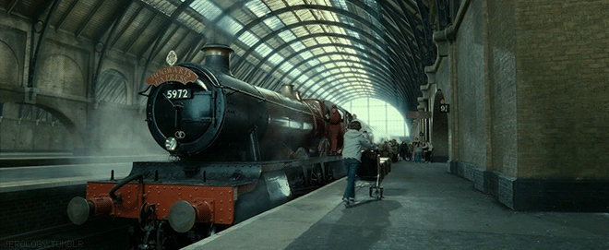
In making of Railway Tracks Cast Iron was :
1. Costly
2. Couldn’t carry a lot of load
3. Needed a lot of maintainence

Slide 19
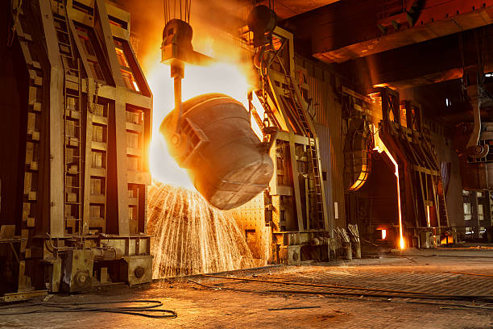
Steel was too expensive at that time .
Hence it was only used to make
Expensive equipments like Swords.
Then a British Engineer,
1. Henry Besmeir invented a cost effective way of making steel due to which
2. The cost of making steel went by nearly 82%.
3. From 40 pounds to 6-7 pounds per long tonn.
“This new discovery of making steel Single-Handedly catalysed the entire Industrial Revolution.”

Slide 20
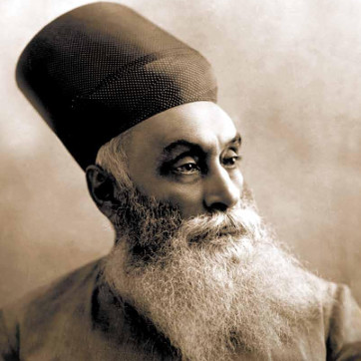
Jamshetji Tata
1. Jamshetji and his team spent not one not five not ten but 17 years of his life, Surveying and Researching on the samples where Iron Deposits could be found in India.
2. Meanwhile he also grew his Textile Industry.
3. Finally his Top Geologist found nearly 8 billion tonnes of Iron Ore in a small village near Jamshedpur in present day Jharkhand.
Jamshetji Tata

Slide 21

Why didn’t the British oppose the Steel Plant?
1. Because the British were aiming to increase the trade wealth
Using expansion of railways.
2. Since importing steel all the back from Britain was a costly process.
3. Neither the British had time to survey the entire subcontinent looking for resources.
4. So they reformed the mining laws so that people like Jamshedji could make use of available resources and supply steel to the government ultimately boosting trade.

Slide 22

World WAR 1
CALL OF DUTY

Slide 23

“ During the World War 1, The Britishers viewpoint upon
Indian Industries grew from being envious to Supportive and encouraging”
So Indian Industries bloomed.

Slide 24


Slide 25
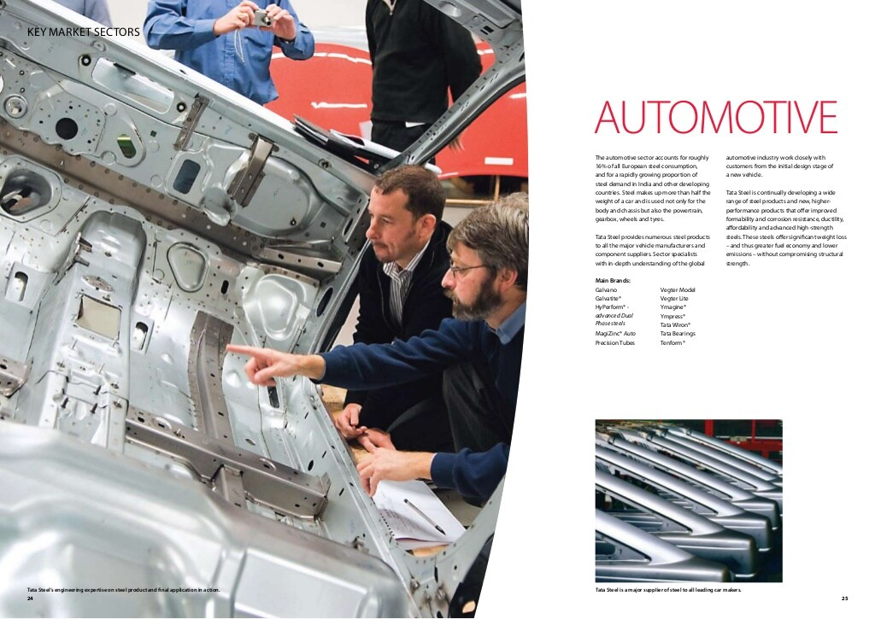

Slide 26


Slide 27


Slide 28
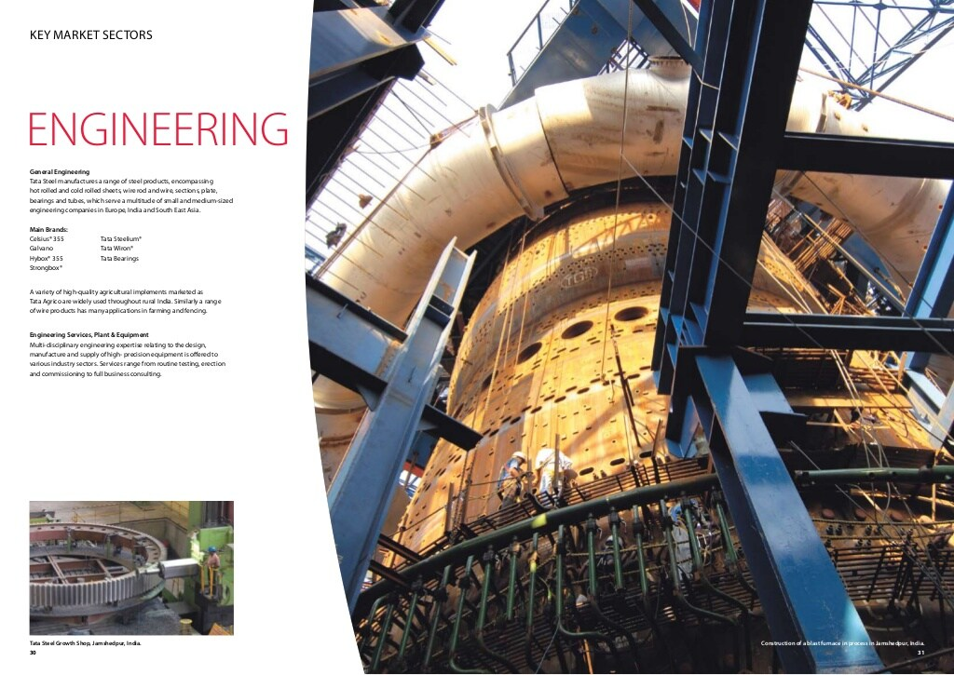

Slide 29
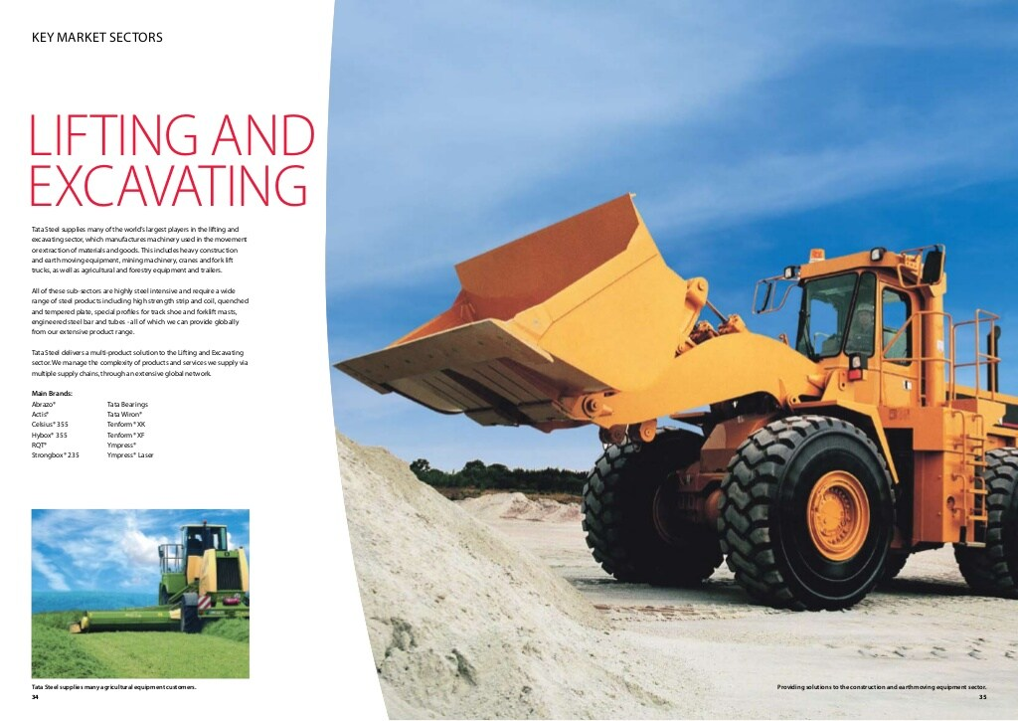

Slide 30


Slide 31


Slide 32


Slide 33
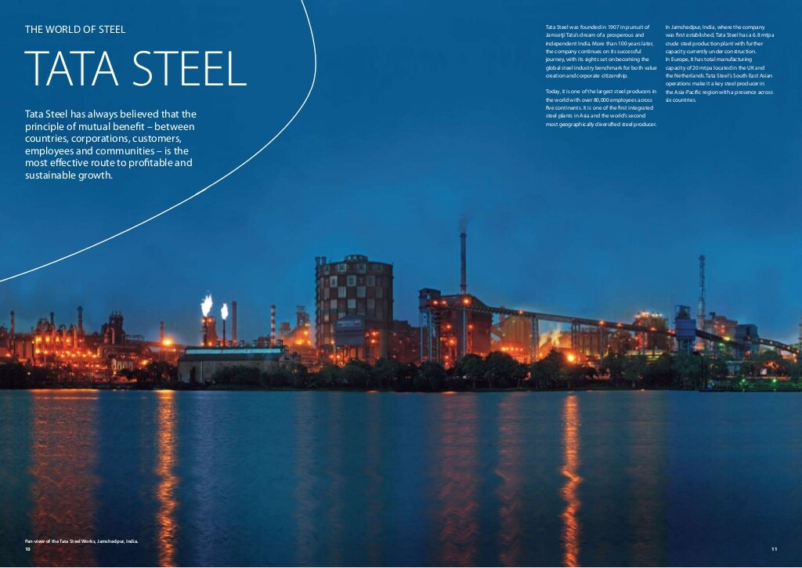
The Liberization of the Indian Economy
unleashed a period of remarkable growth for
the Tata Group, in India and Worldwide.

Slide 34
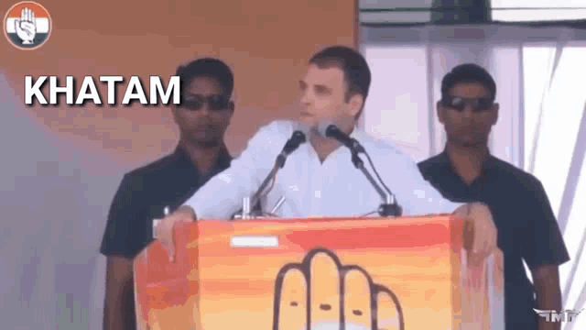

Slide 35

So Any quest1ons ?

